Slide 1
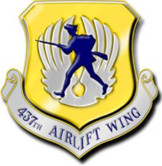
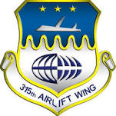
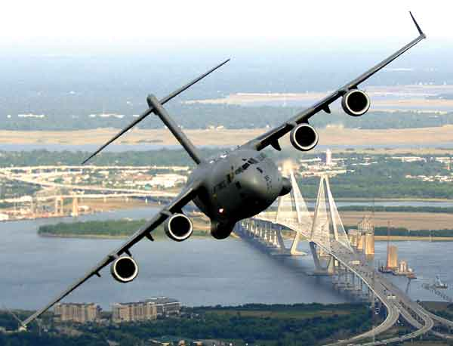
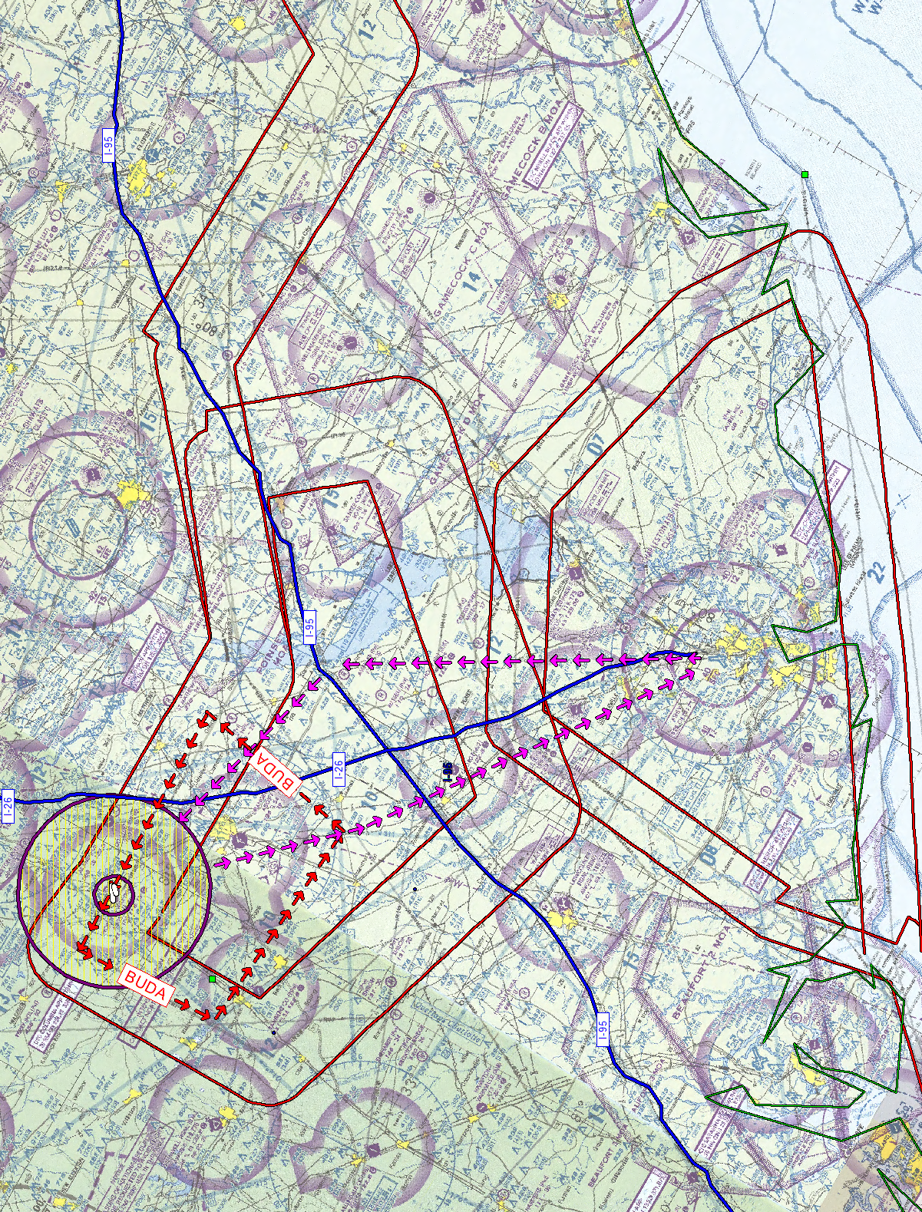
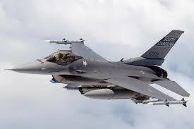
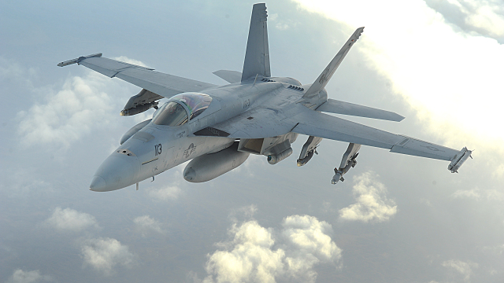
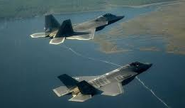
Joint Base Charleston
Mid-Air Collision Avoidance Program
Flight Safety: 843-963-5600
Command Post: 843-963-8400
https://www.jbcharleston.jb.mil/About-Us/Flight-Safety-Programs/Mid-Air-Collision-Avoidance/
This shows highly used airspace and flight routes used by Charleston C-17 Aircraft. This does not come close to encompassing the vast array of military operations occurring throughout the Lowcountry.
Stay Vigilant and aware in the airspace we all share!
Gamecock MOAs
Extensive Fighter Ops when active
IR-35
SFC-4000M
VR-1041
SFC-1500A
Shaw AFB
F-16
Berkeley
MKS
McEntire ANG
F-16
CHS
North Aux Field
Extensive C-17
Operations
IR-36
SFC-4000M
Beaufort MOAs
Extensive Fighter Ops when active
Beaufort MCAS
F-18, F-35

