Slide 1
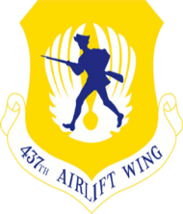
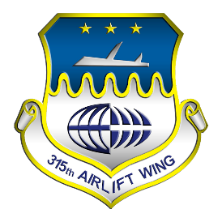
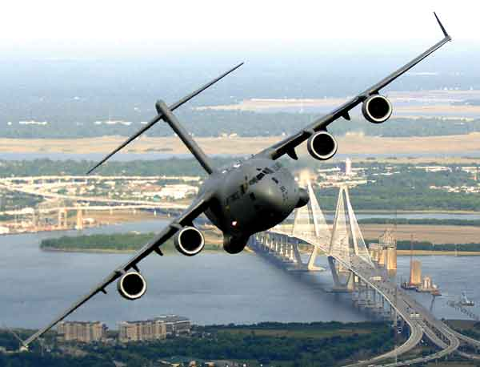
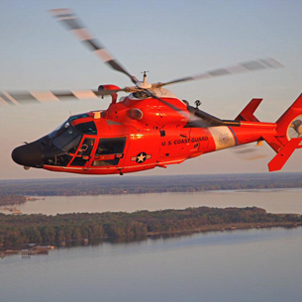
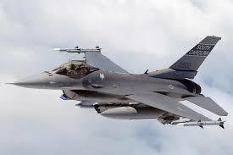
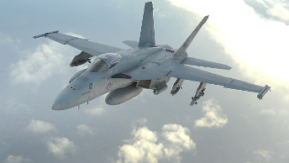
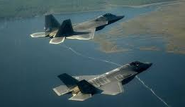
JB CHARLESTON
MID-AIR COLLISION AVOIDANCE (MACA) PROGRAM 2022
Heavy Aircraft
C-17s based at Charleston transit the airspace up to 350 KCAS at altitudes below 2000 feet AGL. C-17 can operate in large (20+) formations in instrument meteorological conditions.
Helicopters
Coast Guard HH-65 helicopters based at Charleston Executive fly approximately 100 KTS and at low-altitudes. They can often be seen over the beaches and in the local traffic patterns.
Fighter Aircraft
F-16s based around Columbia at Shaw AFB and McEntire Joint National Guard Base and F-18s and F-35s based in Beaufort regularly fly low-level routes around Charleston up to 350 KTS. They also fly in Gamecock and the Beaufort MOAs in excess of 600 KTS executing aerobatic maneuvers. Their relatively small size make these fighter aircraft are extremely difficult to see, especially at high airspeeds.
Collision Avoidance Checklist
Plan Ahead → Flight plan route to minimize military training routes and traffic areas
Keeps Eyes Outside → Have charts available and be familiar with headings, altitudes and frequencies
Adhere to Standard Operating Procedures → Fly hemispherical altitudes and cloud clearances
Compensate for Design → Know your aircraft blind spots
Equip for Safety → High intensity lights increase visibility and use a transponder
Speak Up, Listen Up → Talk to ATC and make position reports at non-towered airfields
Use other’s position reports to build situational awareness
Scan, Scan, Scan → Be constantly scanning in your flight path good scanning techniques
JBC FLIGHT SAFETY: 843-963-5600 437AW.FLIGHTSAFETY@US.AF.MIL
https://www.jbcharleston.jb.mil/About-Us/Flight-Safety-Programs/Mid-Air-Collision-Avoidance/
COMMAND POST: 843-963-8400

