Slide 1
JB Charleston
Mid Air Collision Avoidance
437 AW Flight Safety
DSN 963 - 5600

Slide 2

Outline
MACA Background
Airspace
  Special Use Air Space
Traffic Alert and Collision Avoidance System (TCAS)
JB Charleston Operations
Local Military Training Routes
Local Aircraft Types
Hazardous Air Traffic Reports
Right-Of-Way

Slide 3
Background
The majority of mid air and near mid air collision events occur in visual meteorological conditions and daylight hours
Aircrew are never absolved of their responsibility to see and avoid air traffic (IFR and VFR)
If you are involved in a near mid air collision, notify your nearest flight safety office

Slide 4
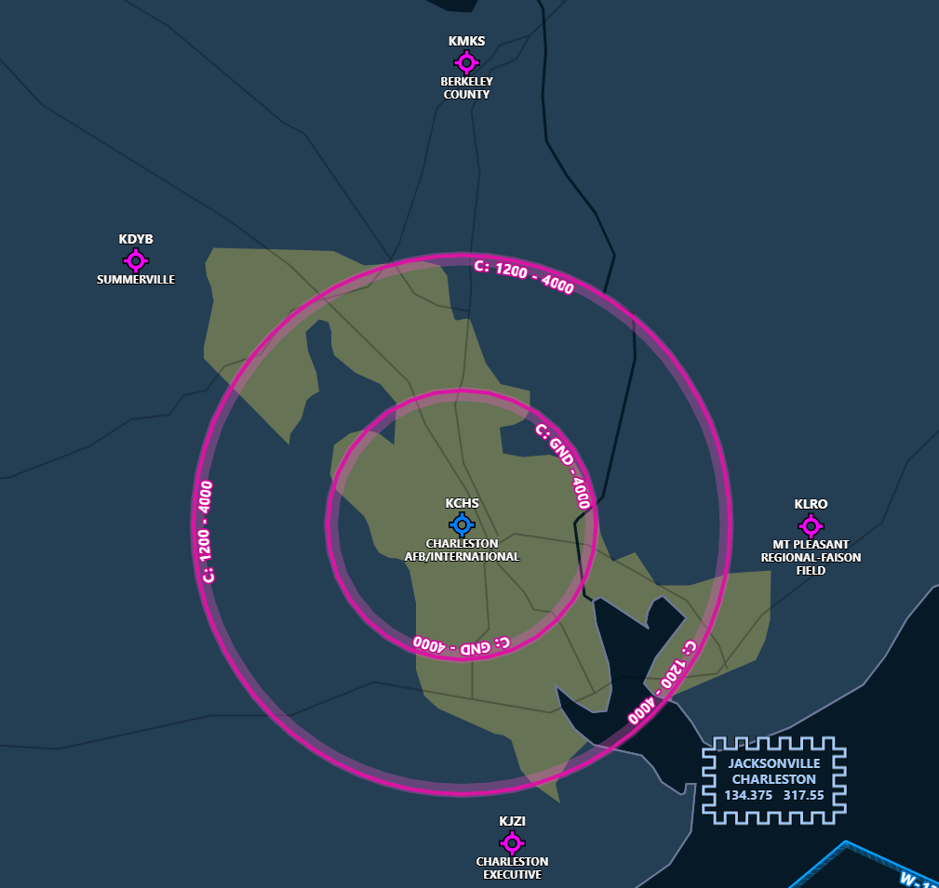
Charleston Airspace
Charleston AFB is located in Class C airspace
GA and regional aircraft operate at Summerville, Moncks Corner, Mt Pleasant and Charleston executive airports

Slide 5
Radar Services
Radar Coverage Around Charleston
  Radar service was developed primarily for the separation of IFR traffic from other IFR traffic
  Controllers will assist VFR traffic as time and facilities permit and call the pilot’s attention to any known potential problem or immediate hazard
  Aircraft with an operational transponder appear the same size on a controller’s screen (regardless of actual size)

Slide 6
Radar Services
  Radar advisory service (aka Flight Following) for aircraft is specifically designated as a duty that follows the priorities of: Separation, Safety advisories, Other required controller actions
    Will be performed on a workload permitting bases only
    Valuable tool to aid controllers in aircraft separation
    Does not alleviate the VFR pilot of separation responsibility
OPR: 437 A/SEF 25 Feb 2016

Slide 7
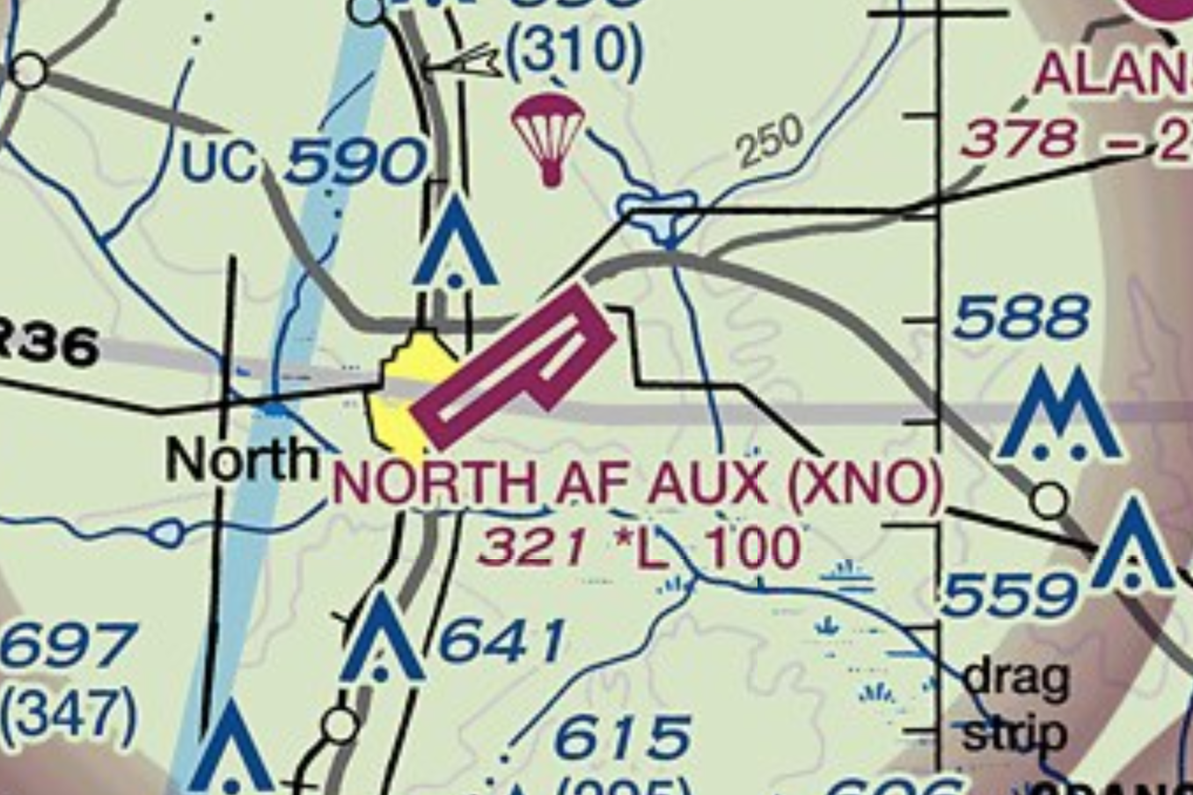
North Aux Airfield
Auxiliary field for C17 and C130 operations
Maintained and operated by 437 AW
Airdrop operations up to 3000’ MSL
Contact KCAE approach prior to operations

Slide 8
Military Operating Areas
  GAMECOCK B-D, POINSETT, BEAUFORT 1-3 MOAS operational by NOTAM
  Aircraft may operate in excess 250 knots <10,000’ MSL
  Activity status may change frequently
  When MOAs in use, non-participating IFR traffic may be cleared through if IFR separation can be provided by ATC
  Pilots should contact ATC or FSS to determine status of MOAs
Source: AIM Section 4 3-4-5

Slide 9
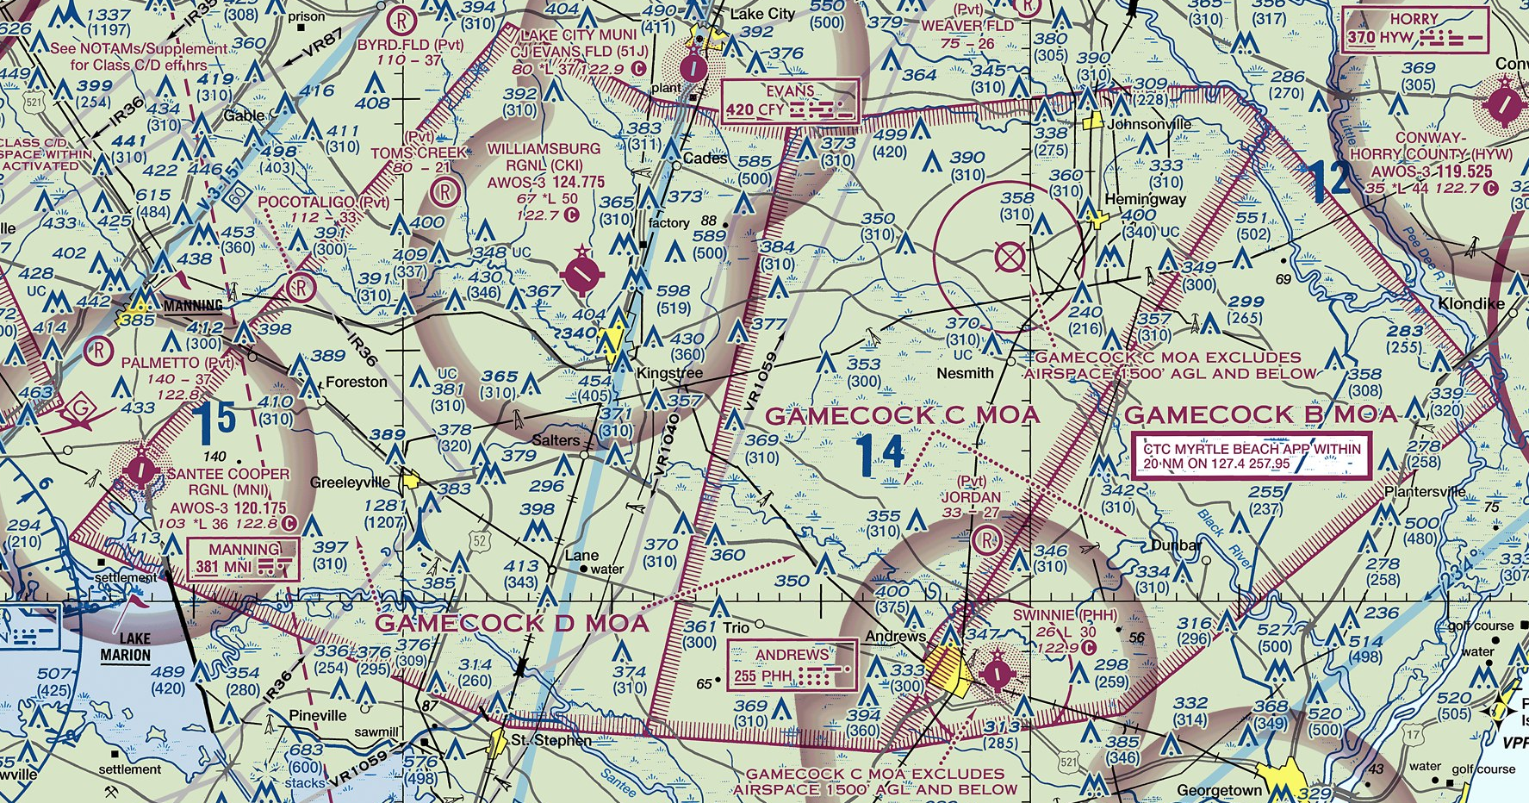
GAMECOCK B-D

Slide 10
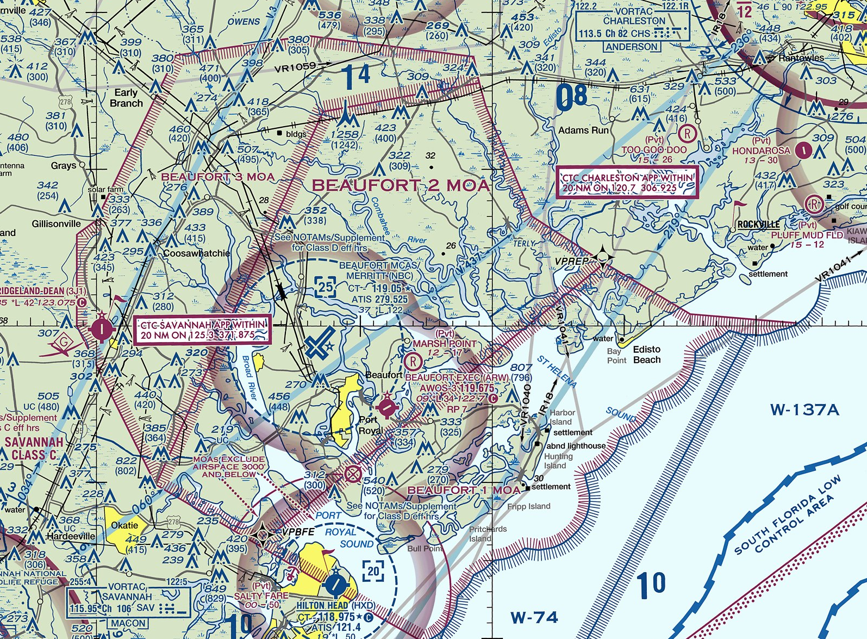
BEAUFORT MOA

Slide 11
Warning Areas
  Numerous warning areas off coast of Carolinas
  Used for military aircraft training including air combat maneuvering, formation operations and air refueling
  Can extend from surface – FL6000
  Contact ATC or FSS for status

Slide 12
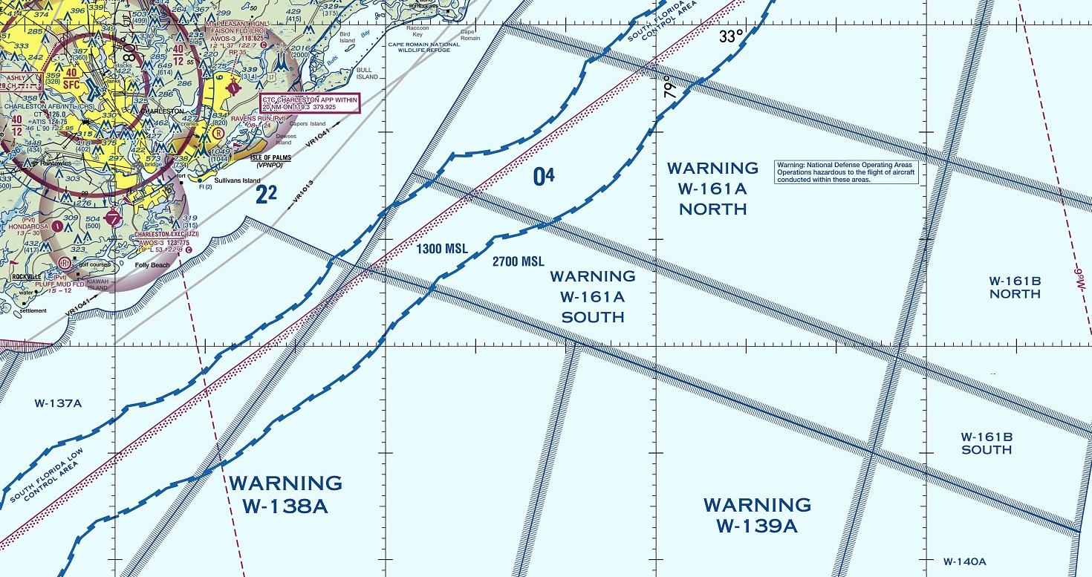
Warning Areas

Slide 13
Local Military Training Routes
Military aircraft operate at high speed on low level military training routes (MTRs)
Solid lines represents the MTR centerline
Dashed lines represents the MTR corridor
  Aircraft may be present anywhere within the corridor
Do not use these products for navigation
OPR: 437 AW/SEF 25 Feb 2016

Slide 14
IR 035
C-17A Normal Entry Point: Alpha
C-17A Normal Exit Point: Golf
Airspeed: 250-310 Knots (C-17)
Altitudes:
  Pt Alpha to Pt Bravo 300-4000’ AGL
  Pt Bravo to Pt Golf 300-3000’ AGL
Additional Notes:
  Instrument route flown in VMC or IMC
  Point G ends at North Aux Field
OPR: 437 AW/SEF 25 Feb 2016

Slide 15
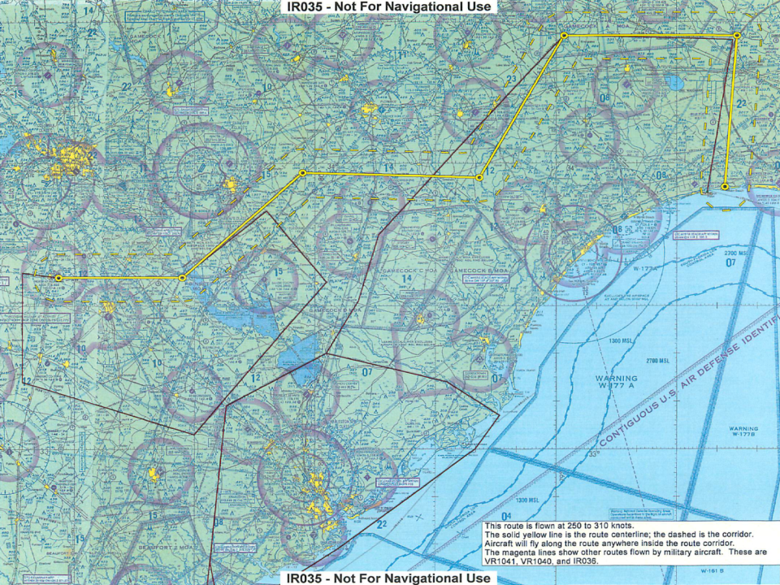
COLUMBIA AIRPORT
Pt Golf
NORTH AUX FIELD
VR1040
Pt Alpha
C-17 VFR OPS
IR036
VR1041
CHARLESTON AIRPORT

Slide 16
IR 036
C-17A Normal Entry Point: Alpha
C-17A Normal Exit Point: Delta
Airspeed: 250-310 Knots
Altitudes: 300-3000’ AGL
Additional Notes:
  Instrument route flown in VMC or IMC
OPR: 437 AW/SEF 25 Feb 2016

Slide 17
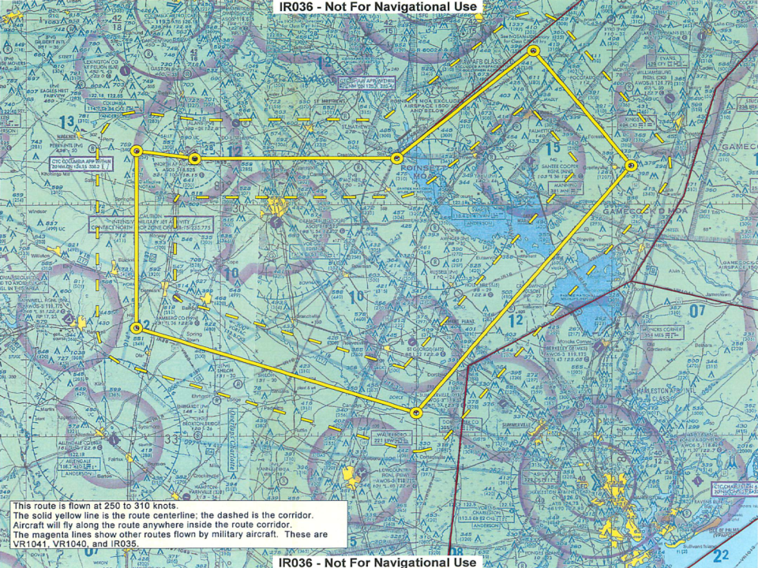
IR035
VR1040
Pt Alpha
VR1041
CHARLESTON AIRPORT
Pt Delta

Slide 18
VR 1040
C-17A Normal Entry Point: Alpha
C-17A Normal Exit Point: Hotel
Airspeed: 250-310 Knots
Altitudes: 300-1500’ AGL
Additional Notes:
  N/A
OPR: 437 AW/SEF 25 Feb 2016

Slide 19
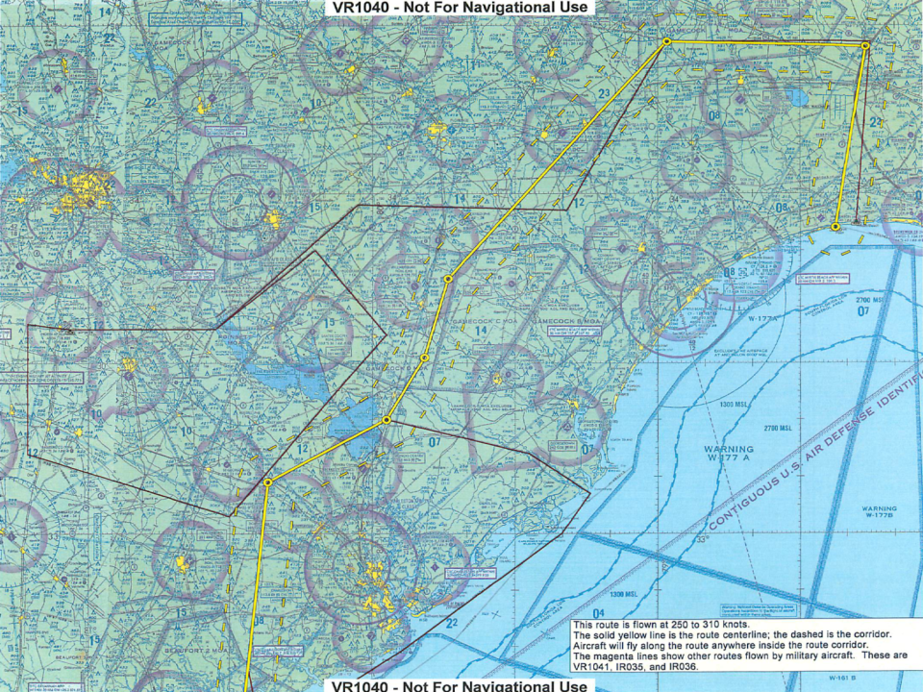
IR035
Pt Alpha
IR036
VR1041
CHARLESTON AIRPORT
Pt Hotel
OPR: 437 AW/SEF 25 Feb 2016

Slide 20
VR 1041
C-17A Normal Entry Point: Alpha
C-17A Normal Exit Point: Foxtrot
Airspeed: 250-310 Knots
Altitudes: 300-1500’ AGL
Additional Notes:
  Climb to 4000-10000’ MSL upon exiting
  Exit speed is 250 Kts
OPR: 437 AW/SEF 25 Feb 2016

Slide 21
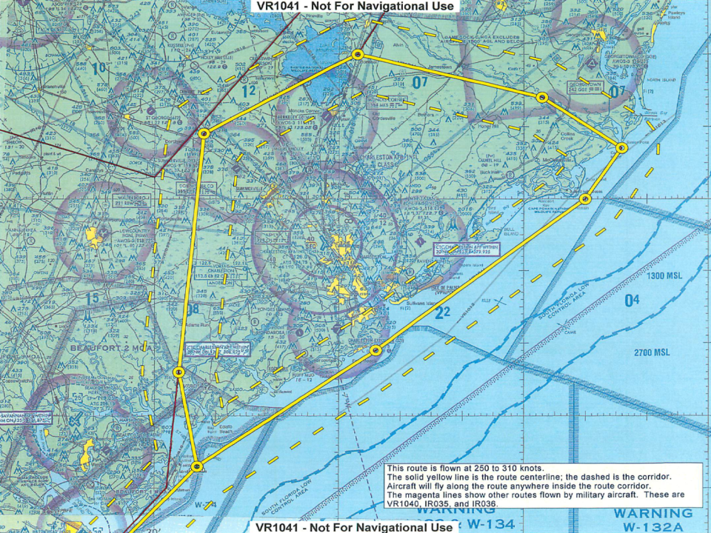
Pt Foxtrot
IR036
CHARLESTON AIRPORT
VR1040
Pt Alpha
OPR: 437 AW/SEF 25 Feb 2016

Slide 22
Traffic Alert & Collision Avoidance System (TCAS)
The C-17A is equipped with TCAS II
TCAS II Basics
  It is not a radar
  It does not respond to aircraft without a transponder or failed transponder
  Is only a tool for traffic separation
  Does not replace the need to visually scan
Why is this important to GA pilots
  Keep your transponder on
  Keep an effective scan, do not expect another aircraft’s equipment to identify a conflict
OPR: 437 AW/SEF 25 Feb 2016

Slide 23
C-17 Operations
Airspeed: 120 KCAS (approach/airdrop) to 350 KCAS
Altitudes: Up to FL450
TCAS II Equipped
Operates in large formations, in instrument conditions
OPR: 437 AW/SEF 25 Feb 2016

Slide 24
Hazardous Air Traffic Report
Crews involved in a near mid air collision or any hazardous air traffic situation should contact their nearest flight safety office within 24 hours
If off station and nearest safety office is unavailable, contact 437 AW Flight Safety
AF Form 651 Hazardous Air Traffic Report

Slide 25
Right of Way Rules
Emergency: An aircraft in distress has right of way over all other traffic
Balloons
Gliders
Airships
Aircraft towing or refueling
All other aircraft

Slide 26
Right of Way Rules
When aircraft of same category are converging, aircraft to the right has the right of way
When approaching head on, each aircraft shall alter course to the right
Each aircraft being overtaken has the right of way, aircraft overtaking others shall alter course to the right to pass well clear
Aircraft on approach or landing have right of way over all others. If both aircraft are on approach, the lower aircraft has the right of way.
Source: 14 CFR 91.113

Slide 27
Contact Info
Flt Safety Office: 843-963-5600
Flt Safety Fax: 843-963-4030
Flt Safety Email: 437AW.FlightSafety@us.af.mil
CHS Command Post: 843-963-8400
OPR: 437 AW/SEF 25 Feb 2016

Slide 28
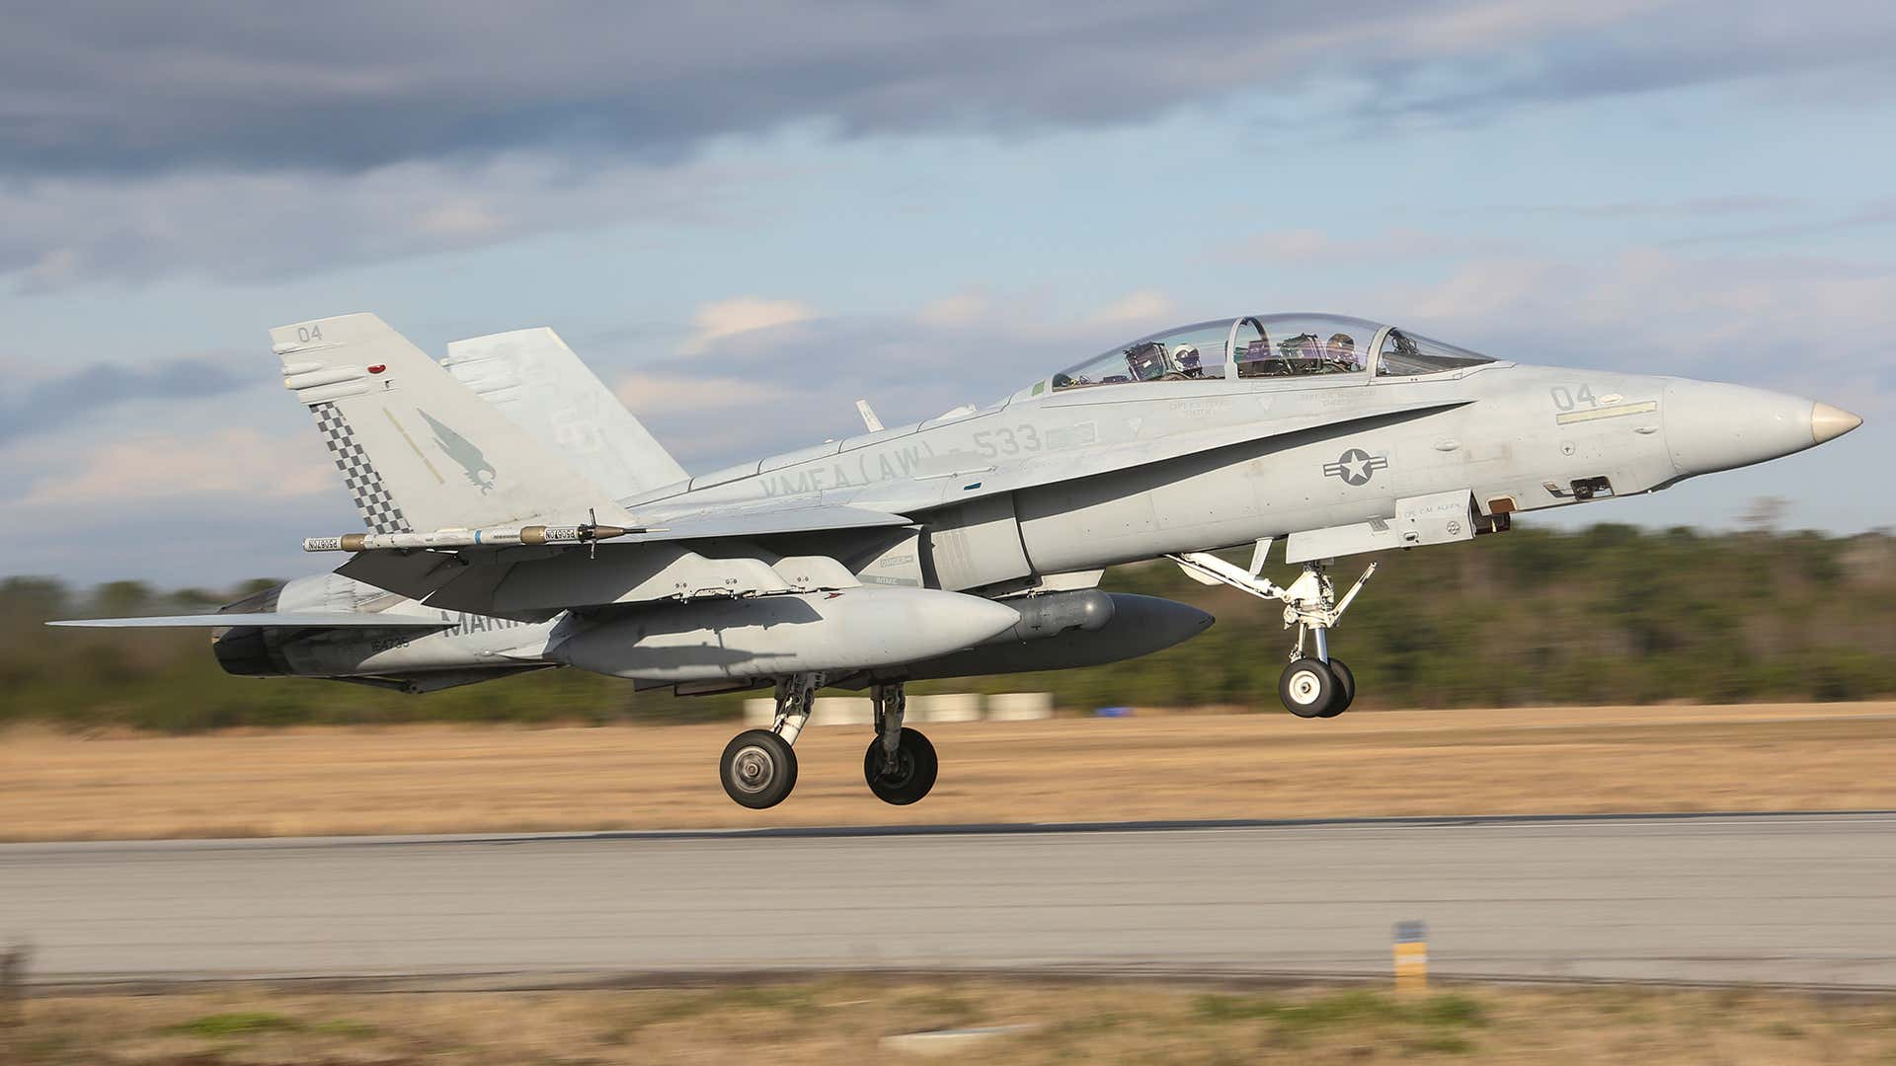
F-18
F-18
  160 KCAS (approach) to 800+ KCAS
  Not TCAS II equipped
  Operate at MCAS Beaufort
  Operate in BEAUFORT MOAs

Slide 29
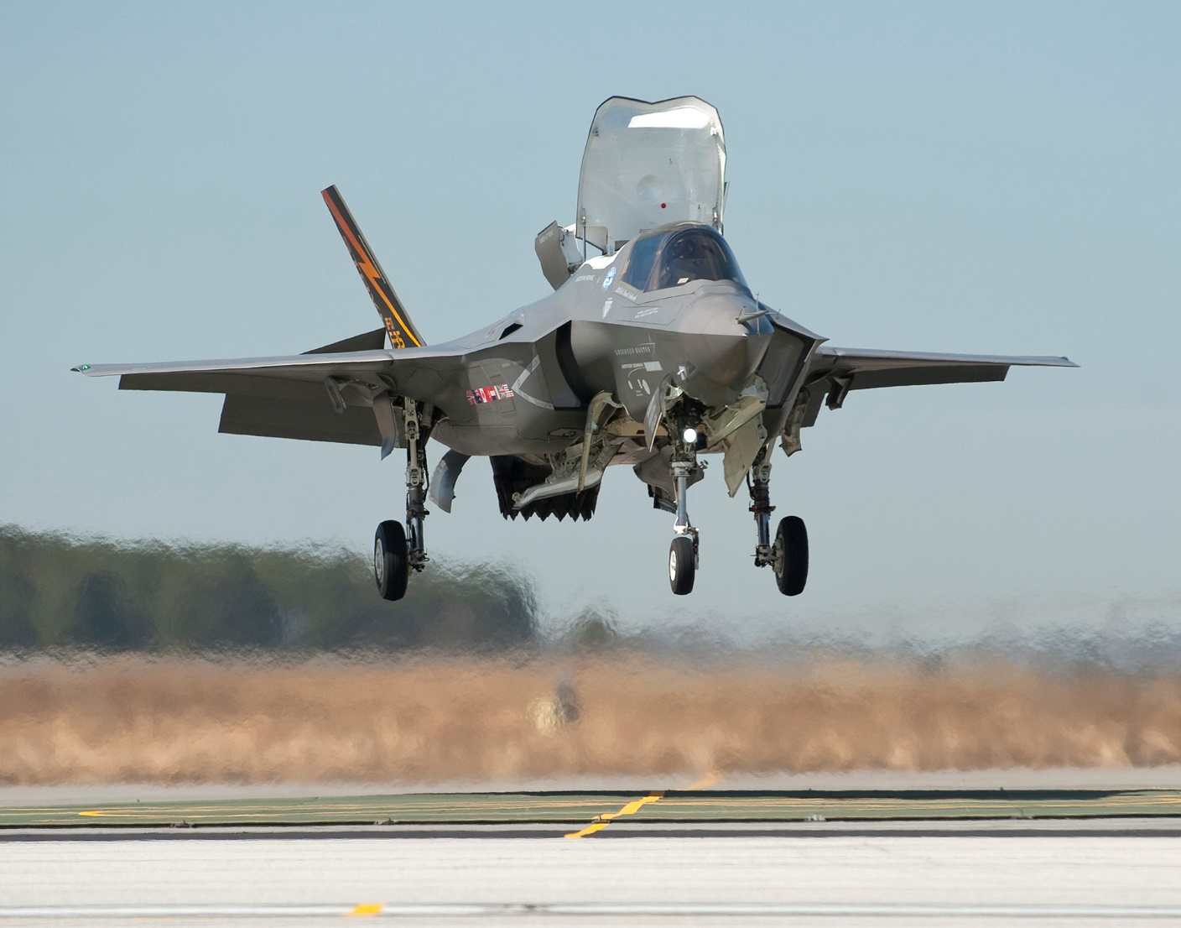
F-35B
F-35B
  150 KCAS (approach) to 800+ KCAS
  Not TCAS II equipped
  Operate at MCAS Beaufort
  Operate in BEAUFORT MOAs

Slide 30
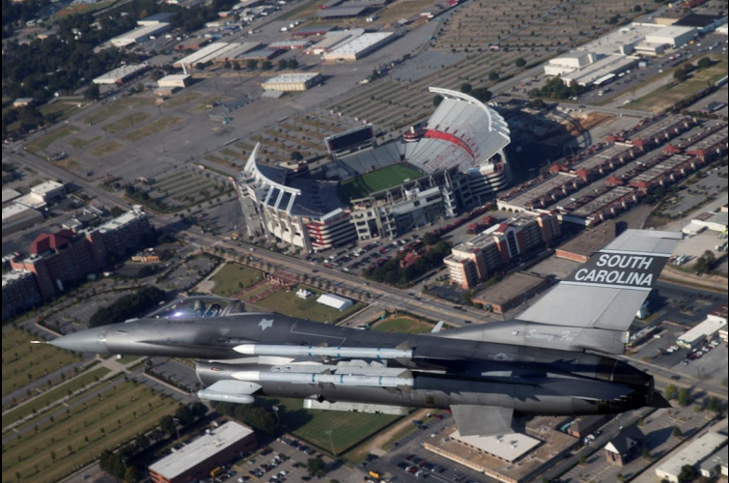
F-16
F-16
  350 kts departure
  300 kts arrival
  150-175 kts final
  Operate at McEntire and Shaw
  Not TCAS II equipped

